Slide 1
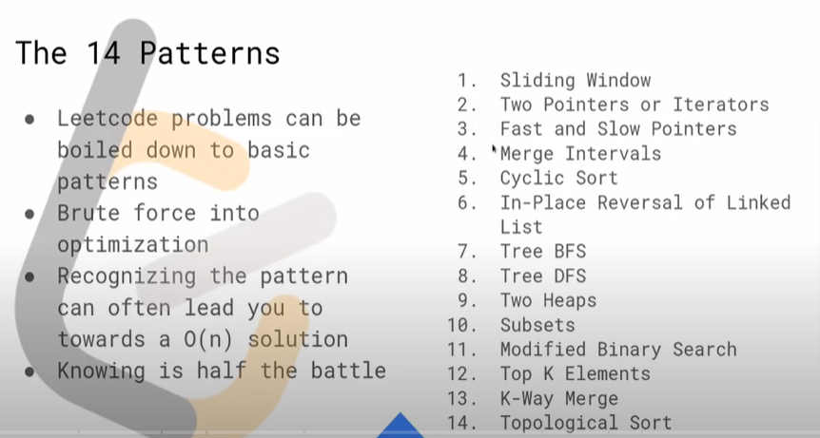
https://www.youtube.com/watch?v=g6TLB_tAaCI

Slide 2
https://www.youtube.com/channel/UC5UgemAz061hkjTFHOfxNpg
⌨️leetcod-patterns repo:
https://github.com/seanprashad/leetco...
⌨️leetcod-patterns list:
https://seanprashad.com/leetcode-patt...
👨🏽‍💻Maximum Average Subarray I:
https://leetcode.com/problems/maximum...
👨🏽‍💻Download Go: https://golang.org/
https://hackernoon.com/14-patterns-to-ace-any-coding-interview-question-c5bb3357f6ed
https://www.techinterviewhandbook.org/best-practice-questions
https://www.techinterviewhandbook.org/grind75
#Algorithmic Patterns for Coding Interviews: Intro
https://www.youtube.com/watch?v=cpgAULF6Vpw
https://seanprashad.com/leetcode-patterns/
https://edcode.xyz/
Leetcode 101: The 14 Patterns Introduction | Workshop (Winter 2022)
https://www.youtube.com/watch?v=g6TLB_tAaCI
https://www.techinterviewhandbook.org/best-practice-questions

Slide 3
TIPS -https://seanprashad.com/leetcode-patterns/
If input array is sorted then
- Binary search
- Two pointers
If asked for all permutations/subsets then
- Backtracking
If given a tree then
- DFS
- BFS
If given a graph then
- DFS
- BFS
If given a linked list then
- Two pointers
If recursion is banned then
- Stack
If must solve in-place then
- Swap corresponding values
- Store one or more different values in the same pointer
If asked for maximum/minimum subarray/subset/options then
- Dynamic programming
If asked for top/least K items then
- Heap
If asked for common strings then
- Map
- Trie
Else
- Map/Set for O(1) time & O(n) space
- Sort input for O(nlogn) time and O(1) space

Slide 4
Sliding Window

Slide 5
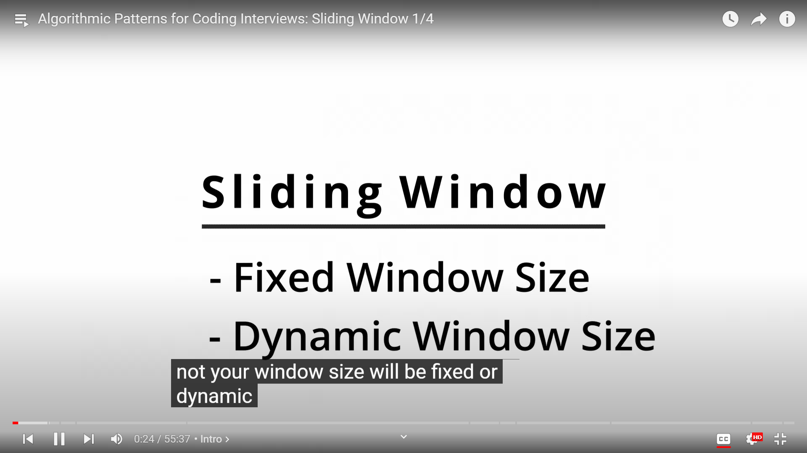

Slide 6
Fixed Sliding Window

Slide 7
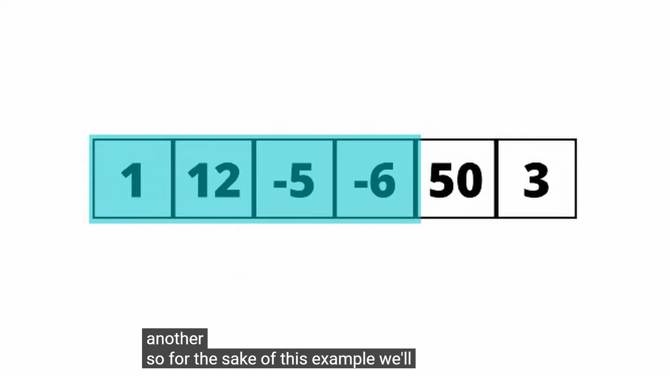
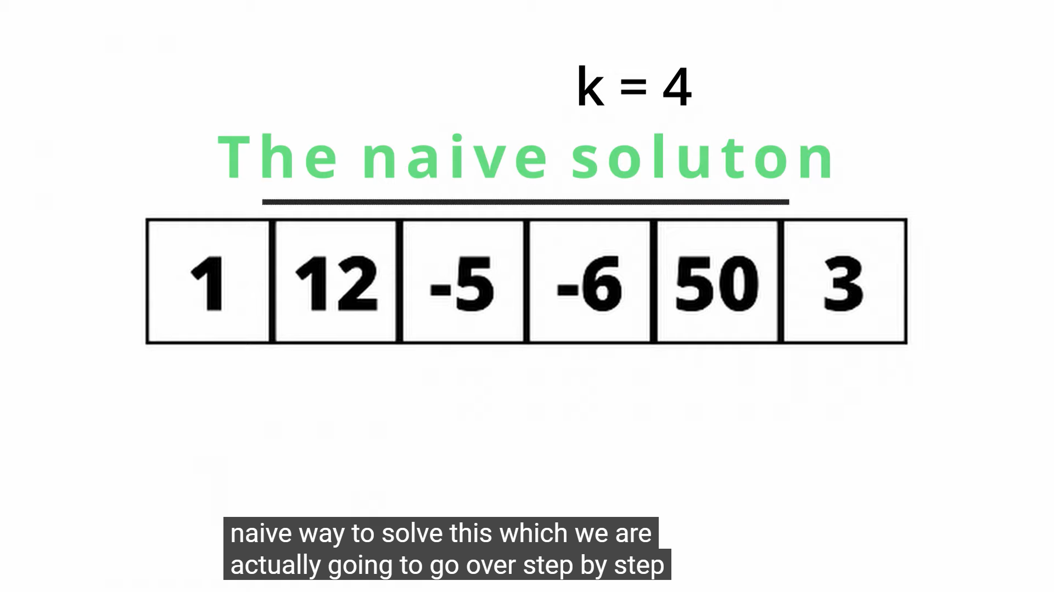

Slide 8
Non Window Sliding operation

Slide 9
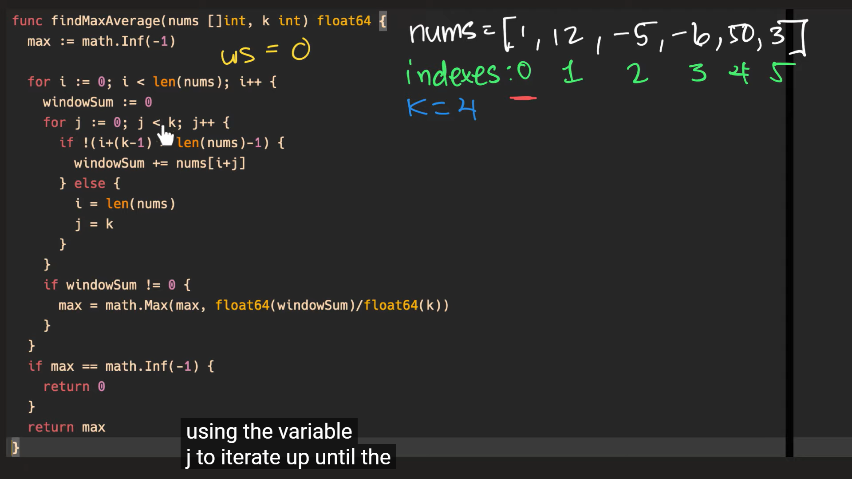

Slide 10
